Slide 1



Slide 2

AI-Powered Pedestrians Detector
01
Introduction
About the System
KHAWLAH ALSHUBATI 19701557
OMAR EL KHADIJI 19700103
Final Presentation GR NO: 01
EMU
CMSE 406 Graduation Project
Prof. Dr. Duygu Çelik Ertuğrul
ASSIST.PROF.DR. ADNAN ACAN

Slide 3
Content
03
04
06
05
01
02
Introduction
PM Tools
Requirement Analyisis
About the System
Design
Implementation
Testing

Slide 4
01
Introduction
System’s Objectives
System’s Objective, scope and aim

Slide 5
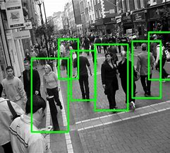
System’s Objectives
Purpose: Windows-based AI-powered System
Scope: Improve safety & security of pedestrians
Perspective: AI (computer vision)

Slide 6
02
PM Tools

Slide 7
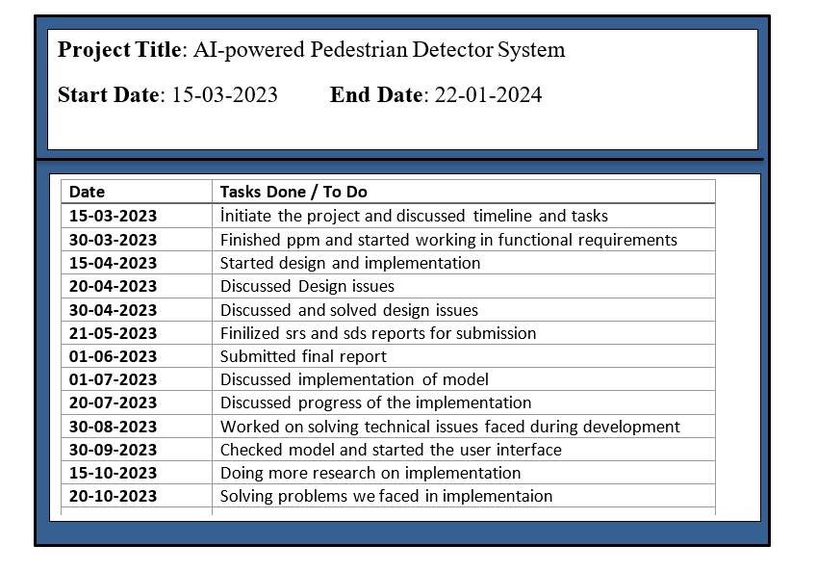
Project Log

Slide 8
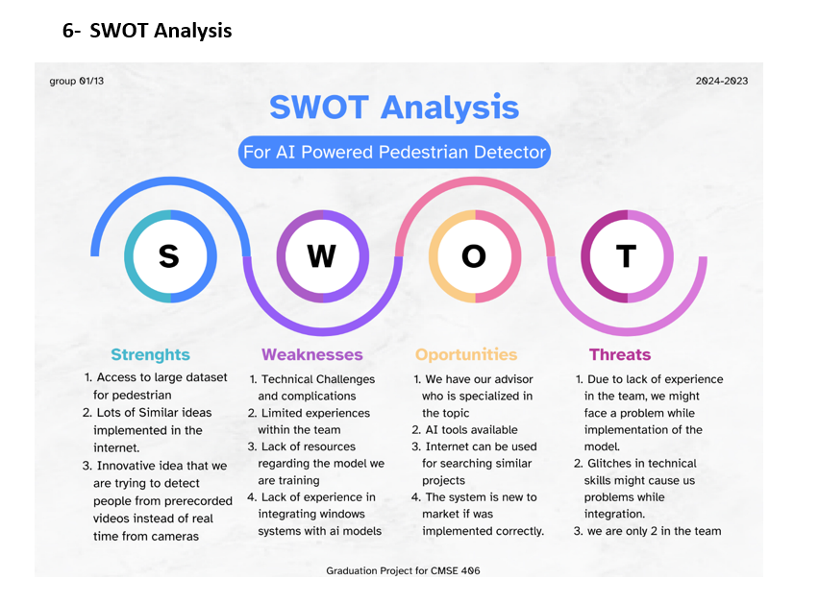
SWOT Analysis

Slide 9
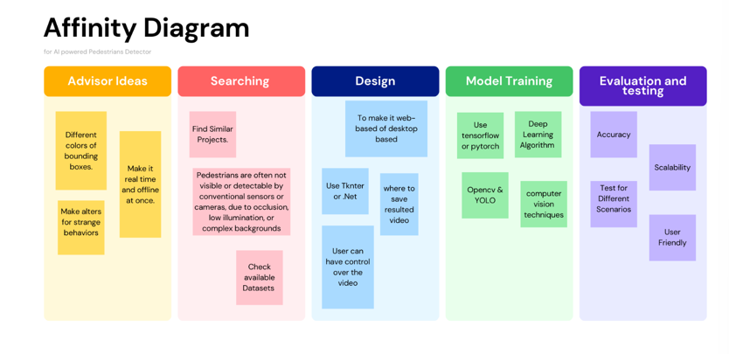

Slide 10
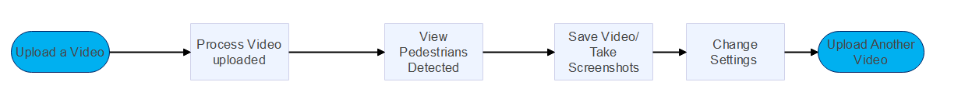
Process Map

Slide 11
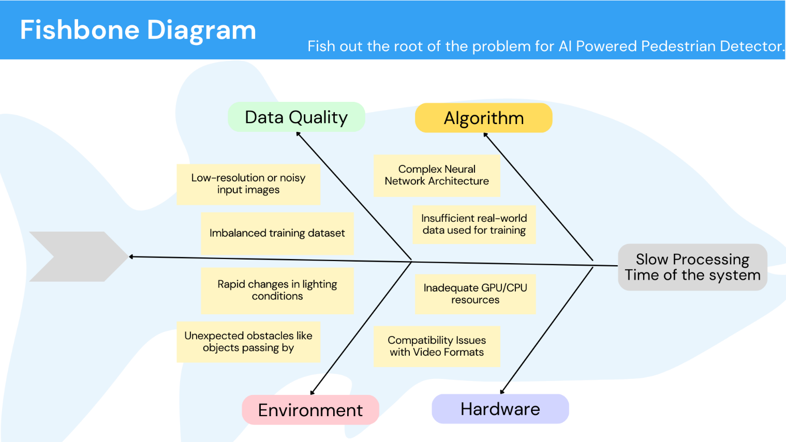

Slide 12
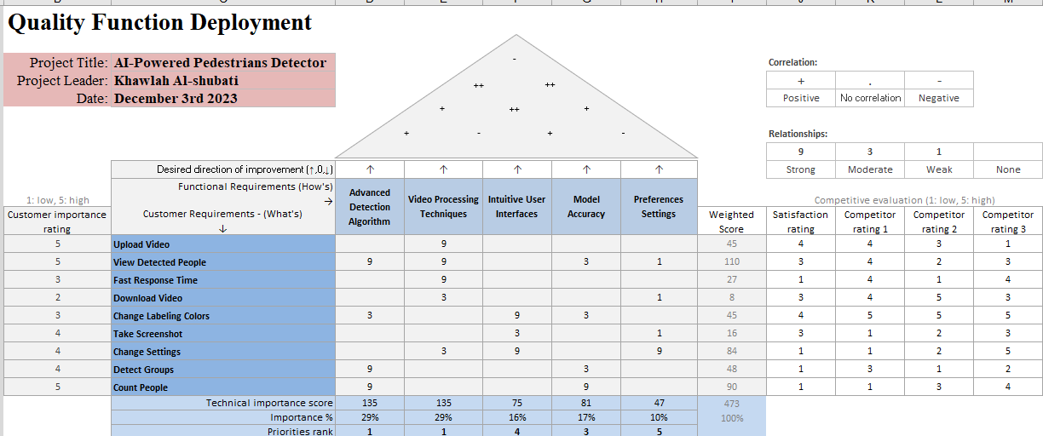
QFD

Slide 13
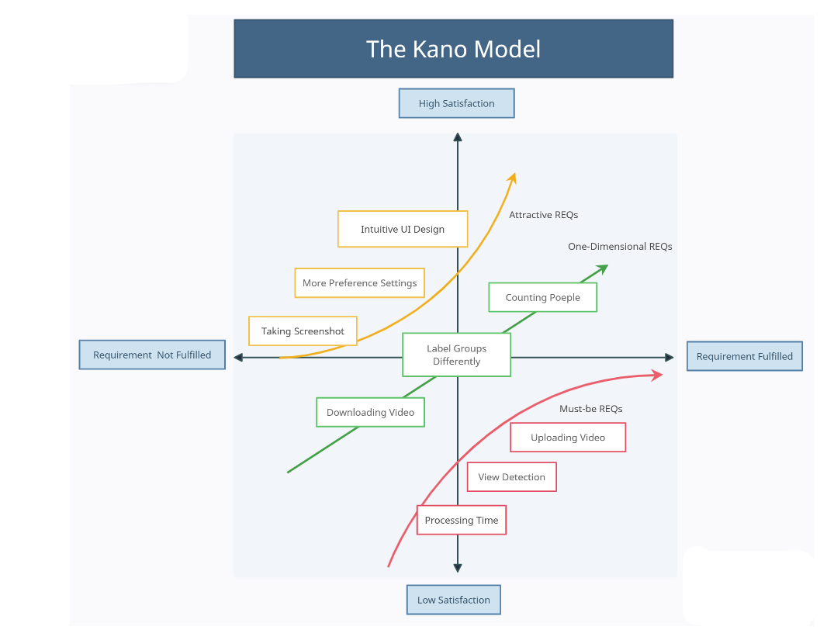

Slide 14
Requirements Analysis
03

Slide 15
Uploading Video
REQ-1: provide “Upload Video” button in the main screen
REQ-2: support the upload of video files of any type
REQ-3: validate uploaded videos for compatibility and provide appropriate error messages for incompatible formats.

Slide 16
View Detected Pedestrians
REQ-1: display original video on one side of the screen
REQ-2: display processed video with labeled pedestrians on the other side
REQ-3: number of detected pedestrians should be shown

Slide 17
Download Video/Take Screenshot
REQ-1: provide a "Download Video" button for the user to save the processed video.
REQ-2: provide a "Take Screenshot" button for capturing and saving screenshots.
REQ-3: allow users to specify the destination for downloaded files.

Slide 18
Uploading Another Video
REQ-1: "Upload Another Video" button to allow users to upload additional videos.
REQ-2: support the upload of video files of any type
REQ-3: validate uploaded videos for compatibility and provide appropriate error messages for incompatible formats.
REQ-4: display the newly uploaded video in place of previous video

Slide 19
User Preferences & Settings
REQ-1: options to toggle the inclusion of labels in the detection display.
REQ-2: options to toggle the inclusion of accuracy information in the detection display.
REQ-3: option to enable or disable crowd detection option.
REQ-4: option for user to choose a color for crowd labels.
REQ-5: option for user to choose a color for single pedestrian labels.
REQ-6: "Save Changes" button to confirm and save user preferences.
REQ-7: "Change Settings" button to discard changes and return to the previous settings.

Slide 20
04
Design Specifications

Slide 21
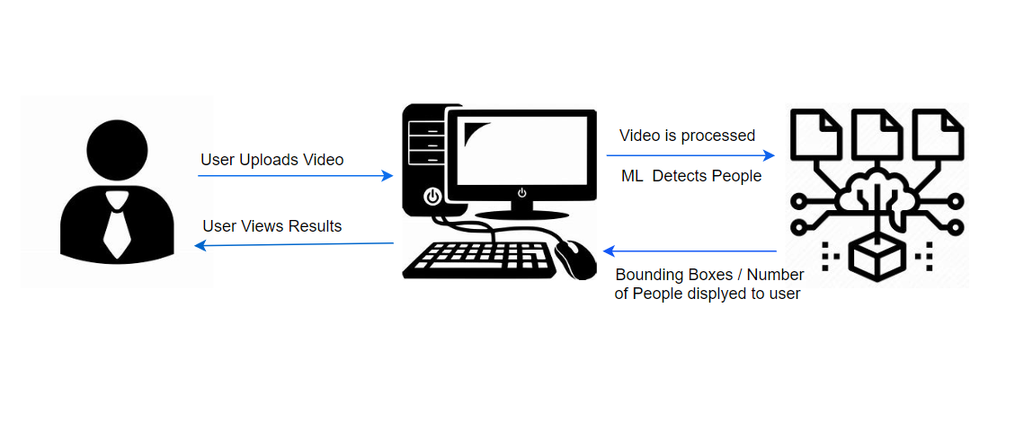
Architicure Diagram

Slide 22
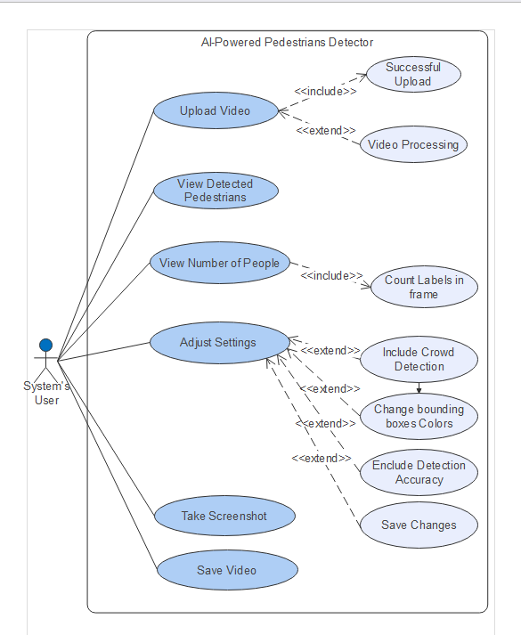
Use Case

Slide 23
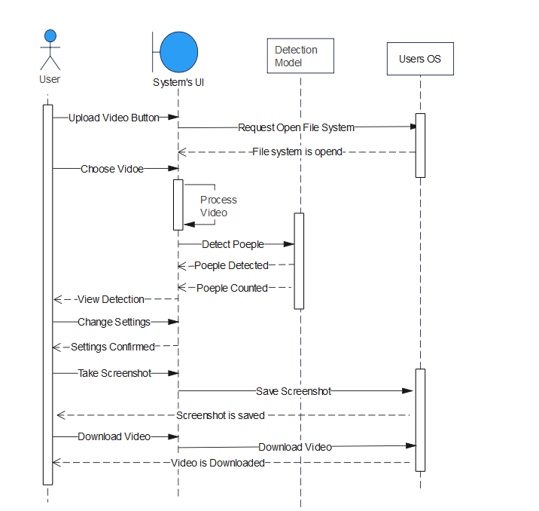
Sequence Diagram

Slide 24
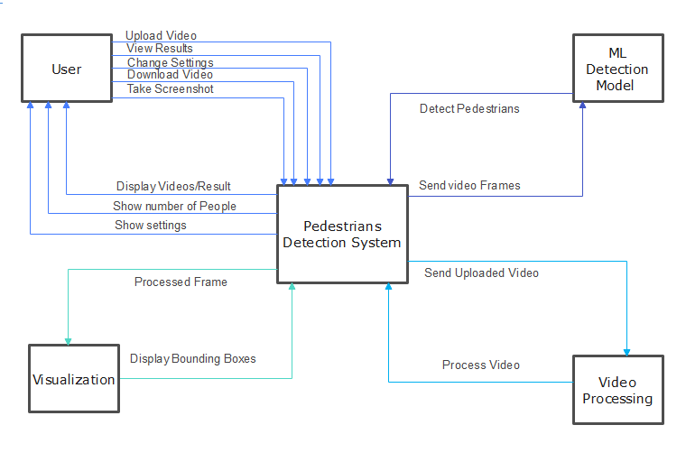
Context Diagram

Slide 25
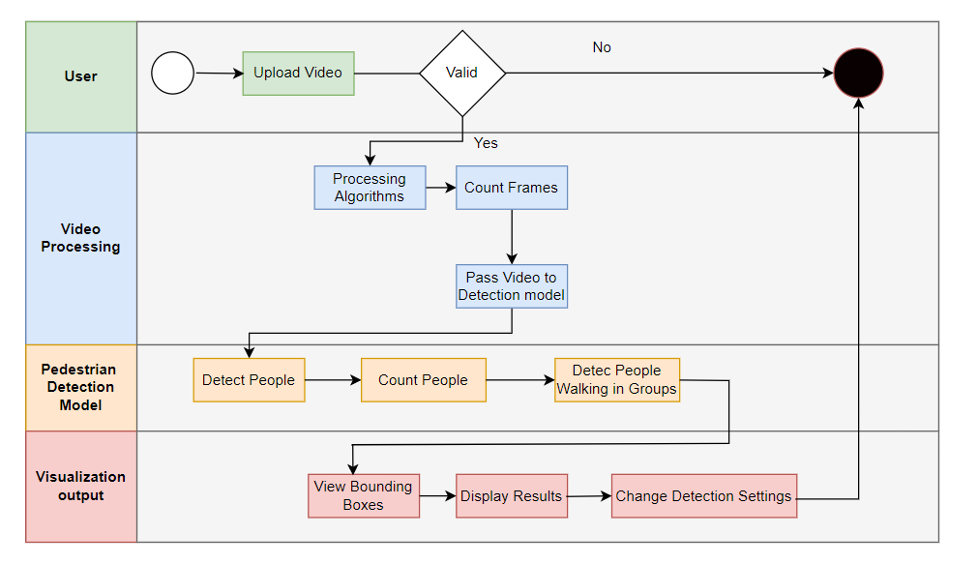
BPMN

Slide 26
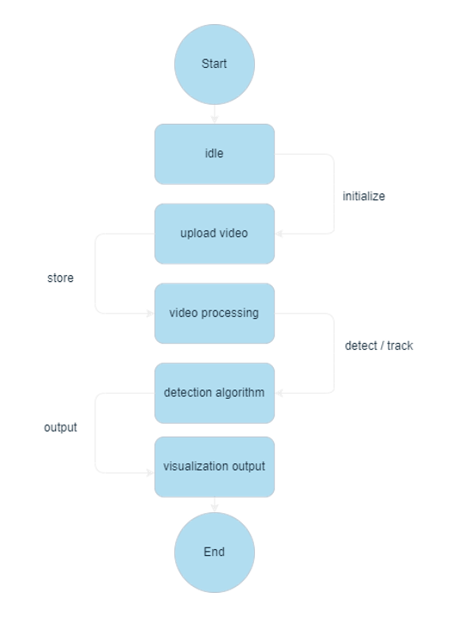
State Diagram

Slide 27
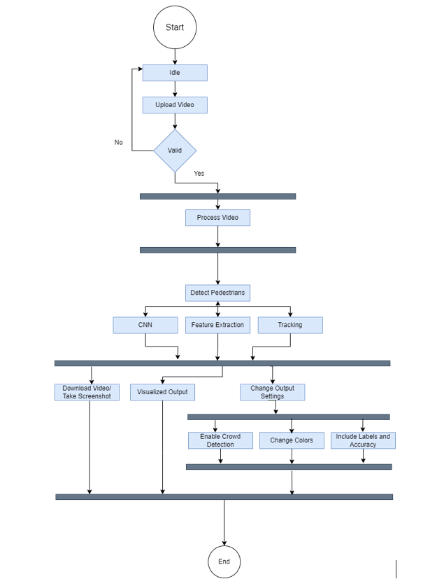
Activity Diagram

Slide 28
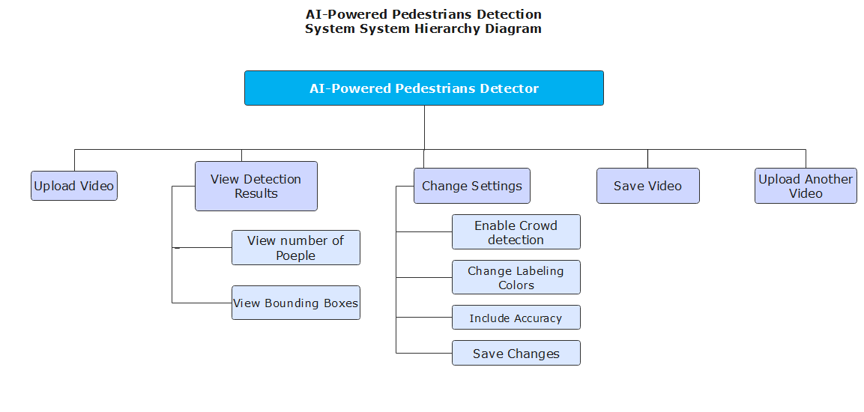
Modular Hiararachy

Slide 29
05
Demo + Tools and Algorithms

Slide 30
Models Tools
Security
Prevent unauthorized access ,
TensorFlow
SSD MobileNet Model
COCO Dataset, 200000 Labeled Images, 80 Object Categories
Safety
Ensure system operates reliably = no harm

Slide 31
User Interface Tools
Tkinter
OpenCV
NumPy
Pillow

Slide 32
Environment/Platforms
Windows OS
VS Code /PyCharm/CoLab
GitHub

Slide 33
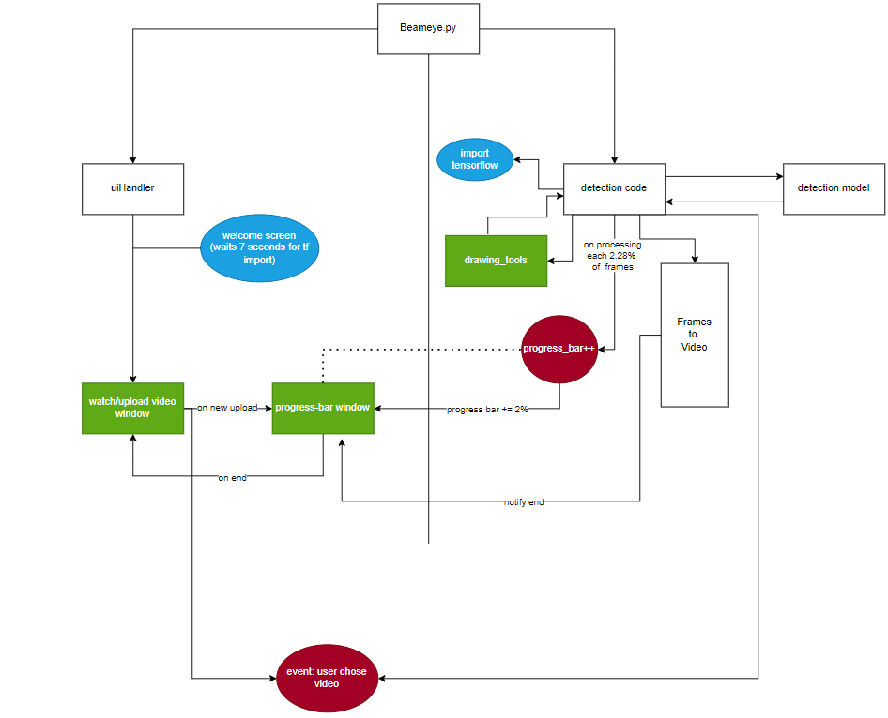
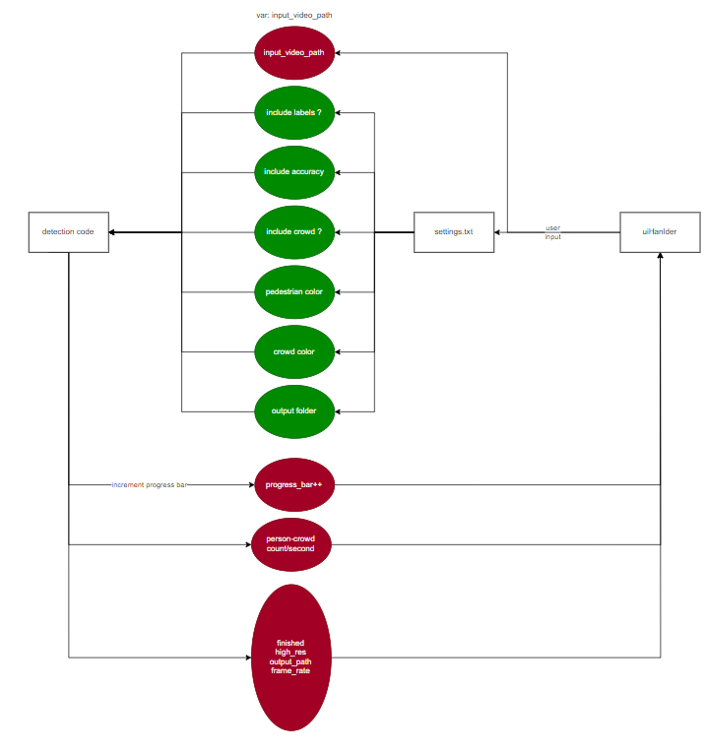
Environment/Platforms

Slide 34
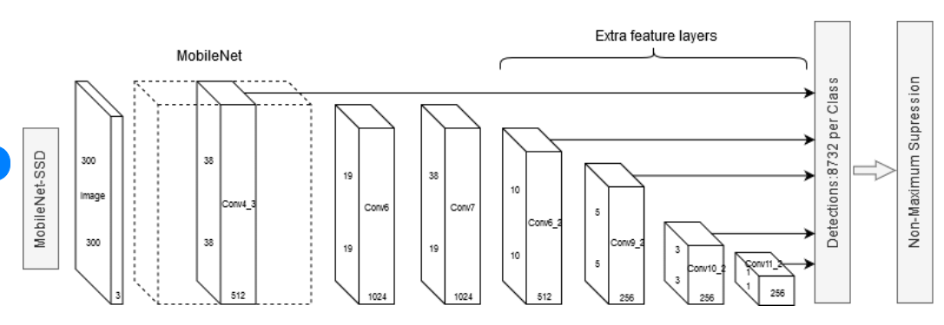

Slide 35
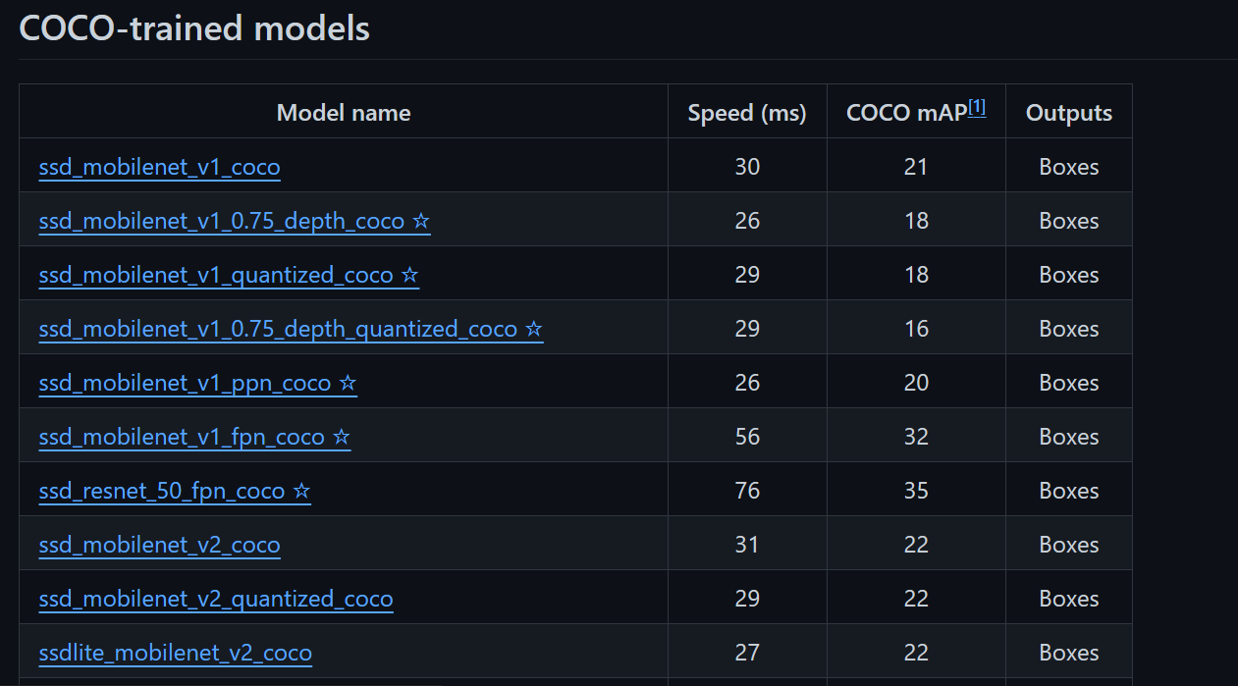

Slide 36
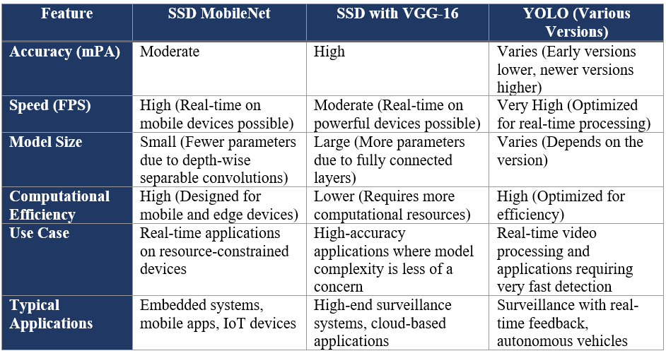

Slide 37
06
Quality Control and Quality Assurance

Slide 38
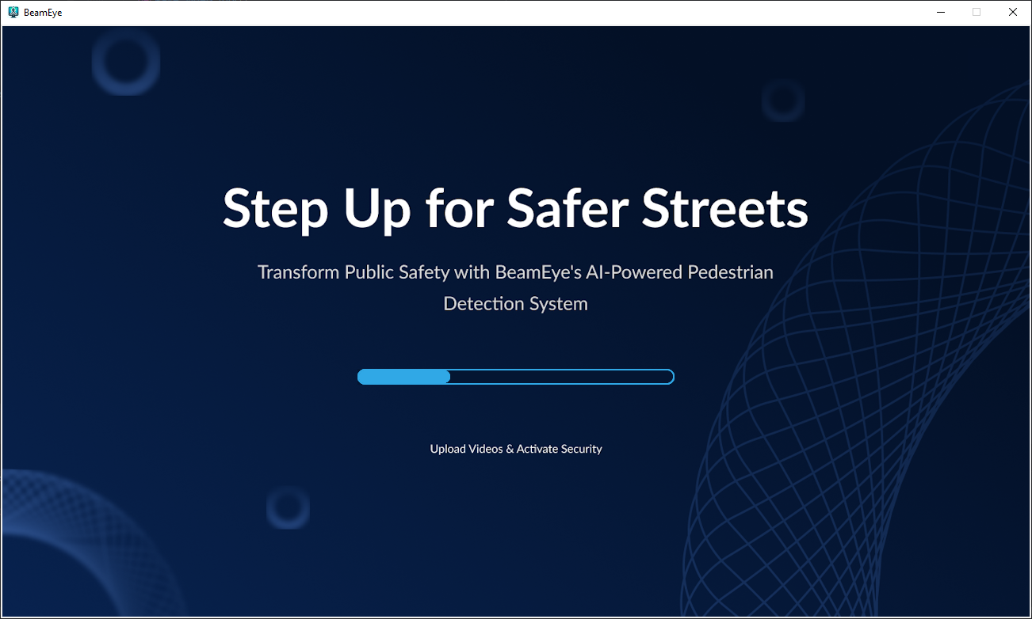

Slide 39
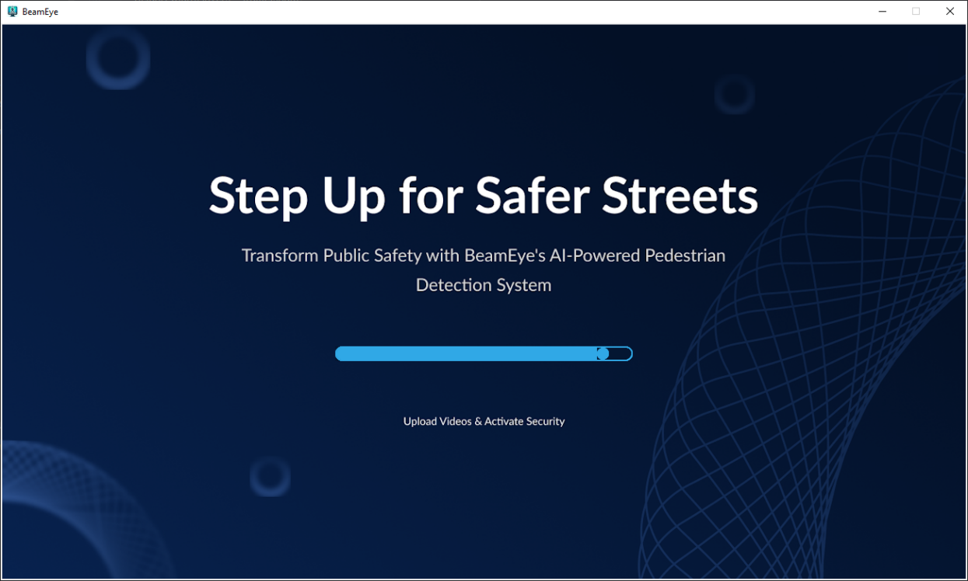

Slide 40
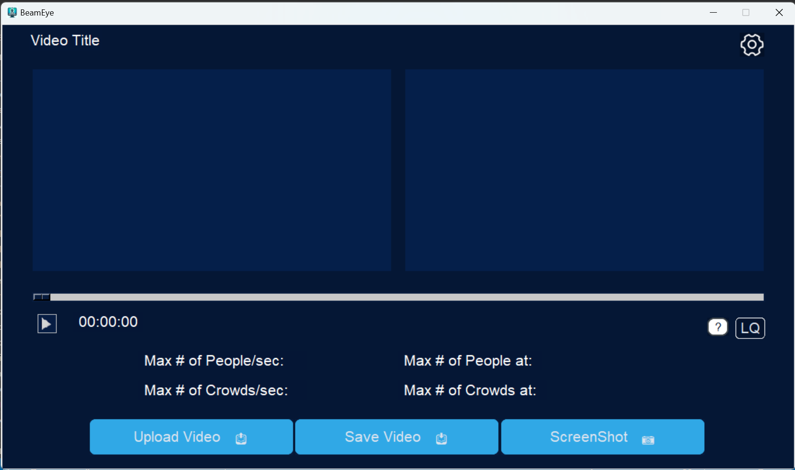

Slide 41
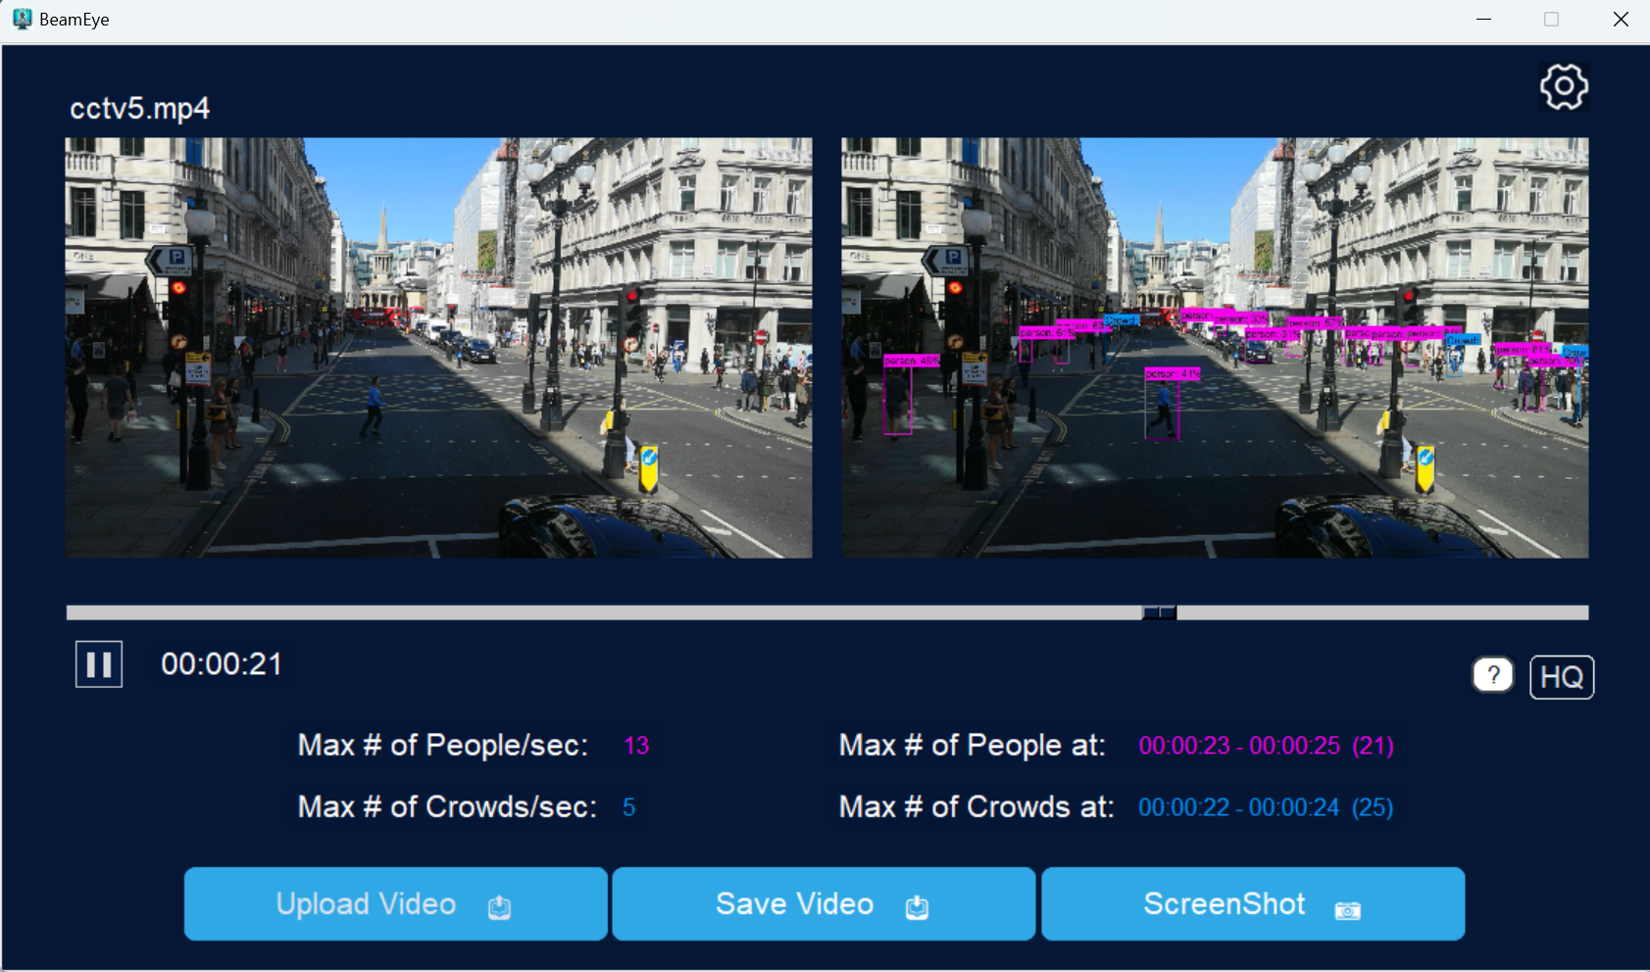

Slide 42
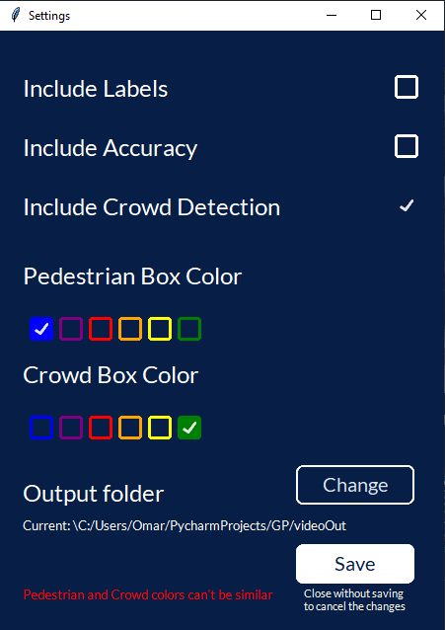
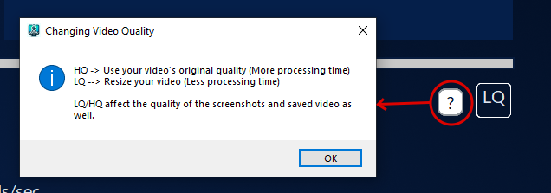

Slide 43
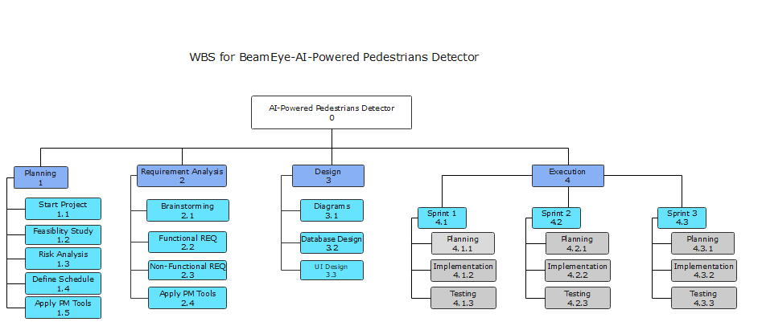

Slide 44
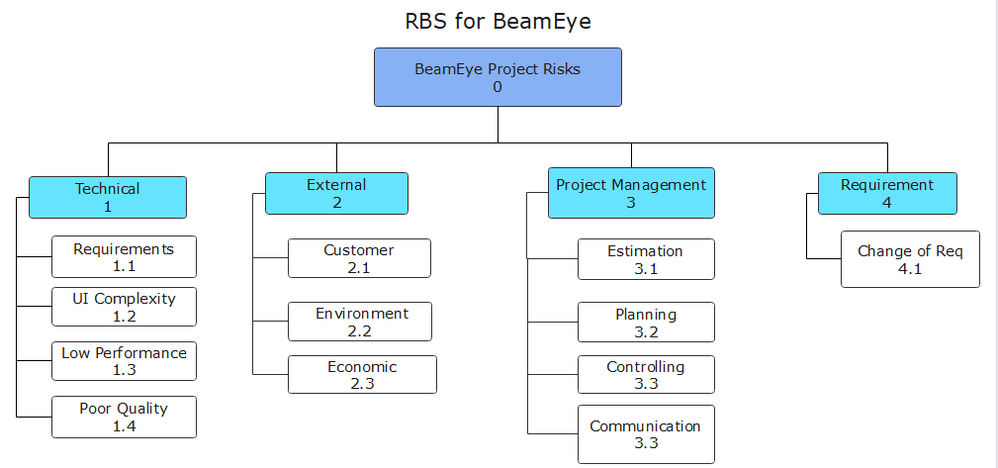

Slide 45
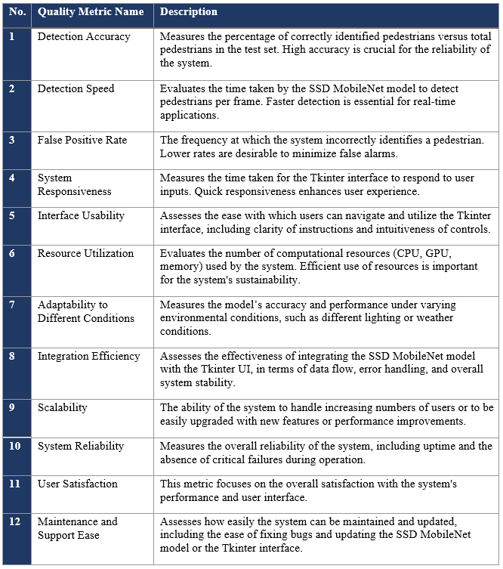
Quality Matric

Slide 46
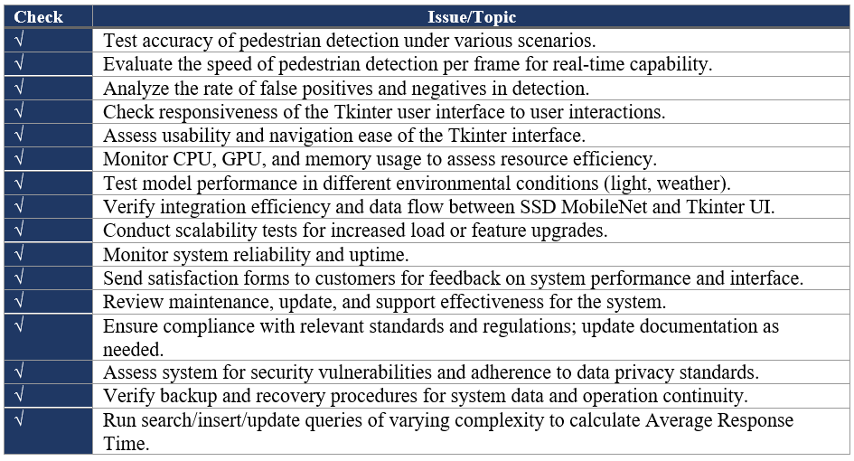
Check Quality

Slide 47
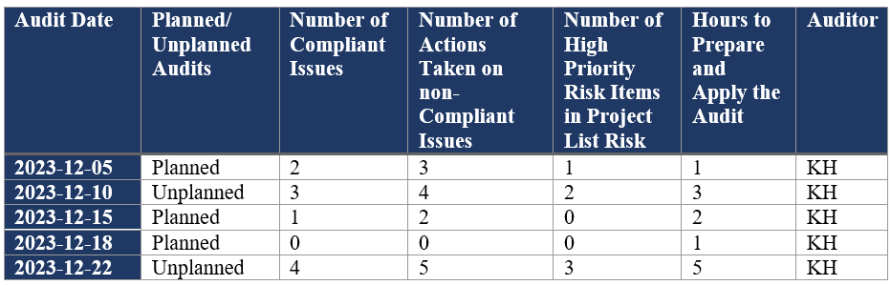
Quality Audit Checklist

Slide 48
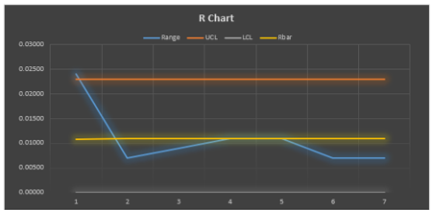
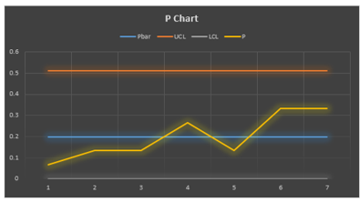
Control Charts

Slide 49
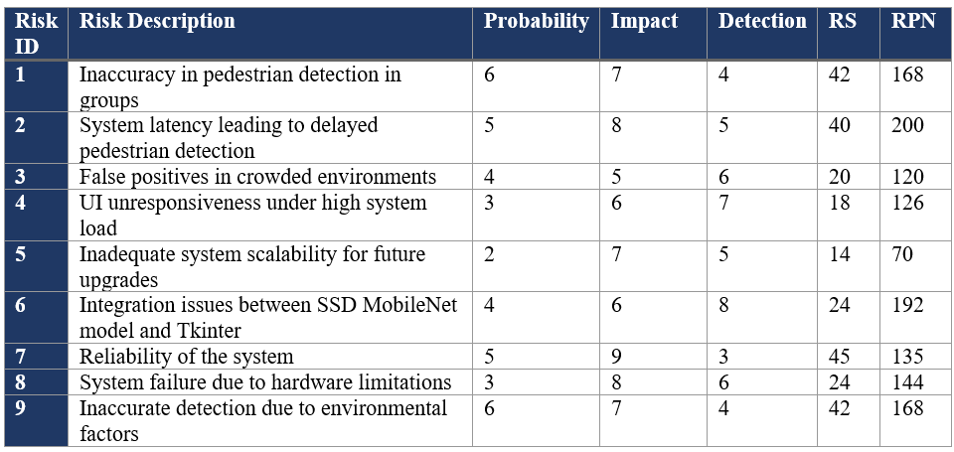
PFMEA

Slide 50
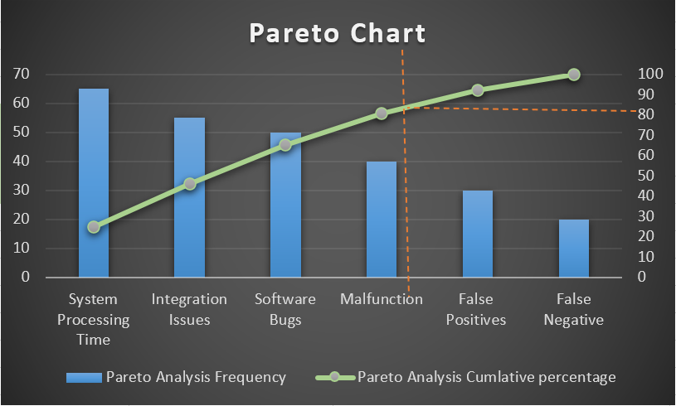
Pareto Chart

Slide 51
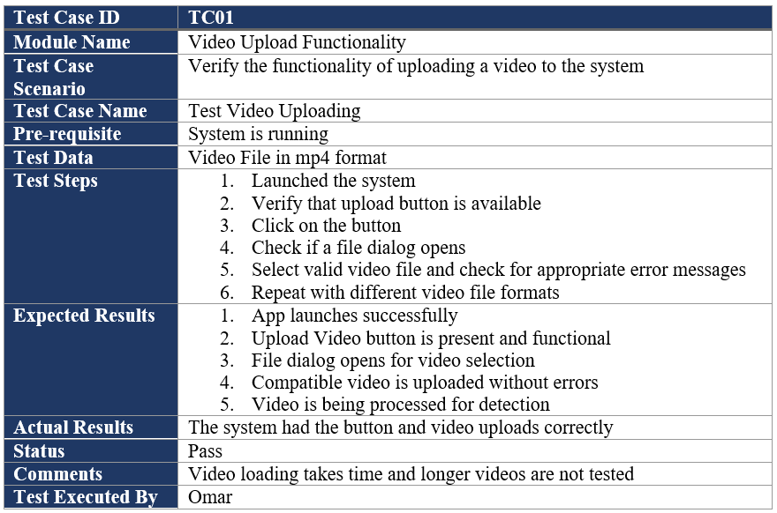
Test Cases

Slide 52
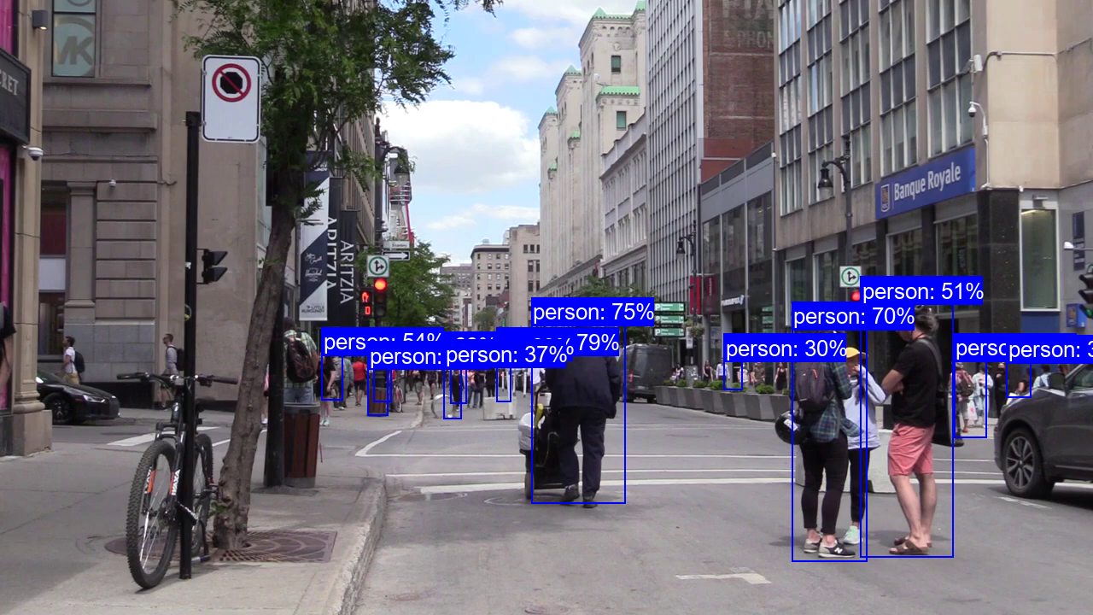
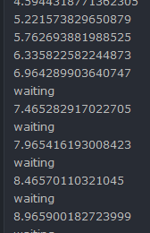
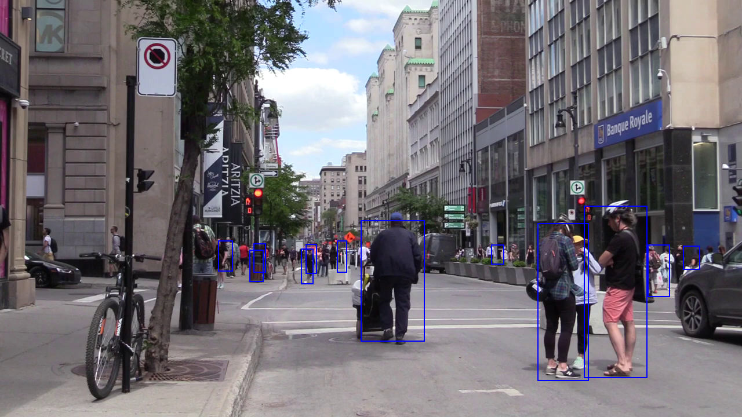
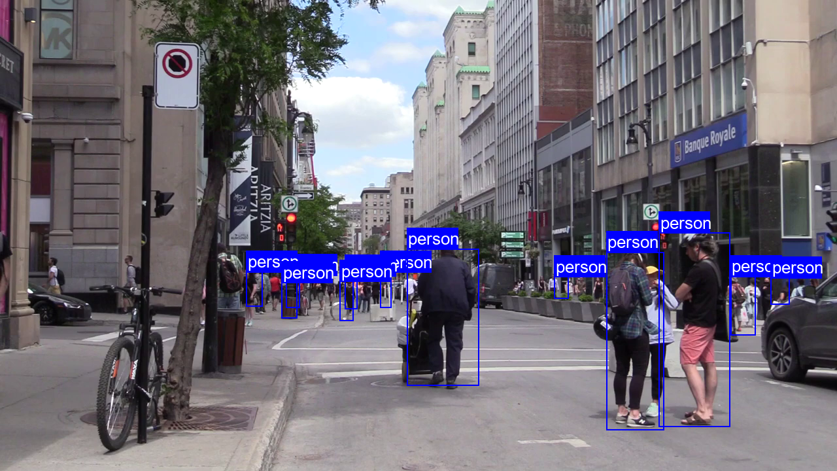
Test Case 02

Slide 53
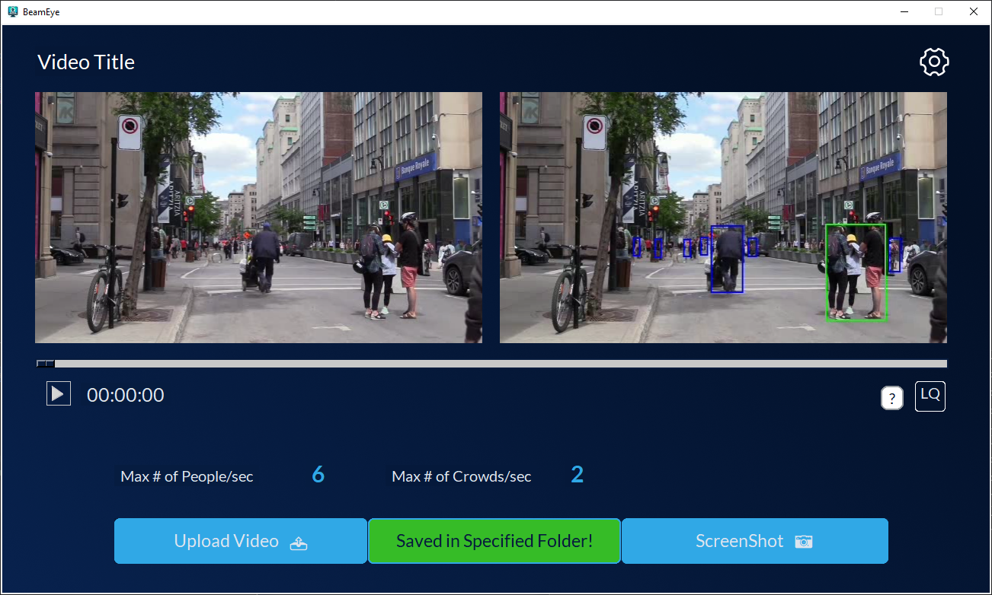
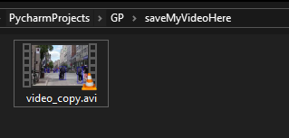
TC03

Slide 54
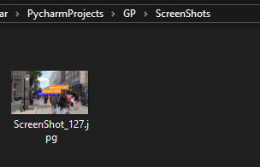
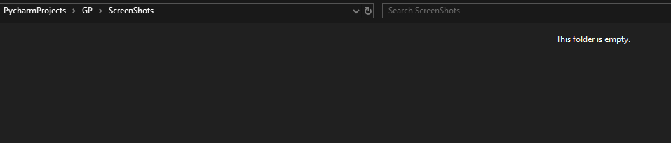
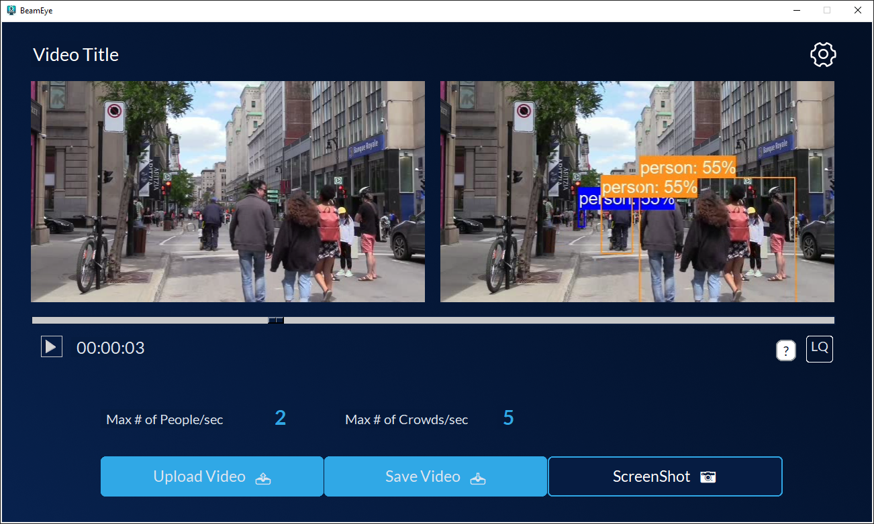
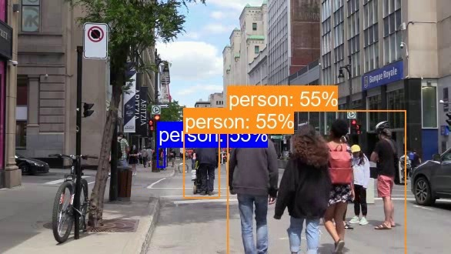
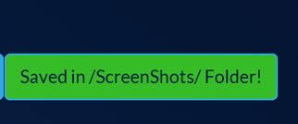
TC03

Slide 55
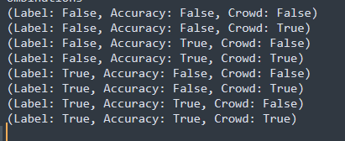
TC04

Slide 56
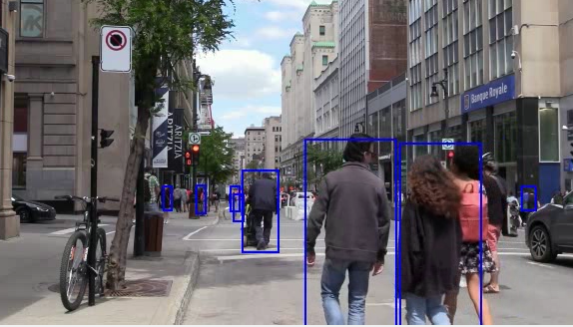
All False

Slide 57

Crowd = Ture

Slide 58

Accuracy True

Slide 59

Crowd and Accuracy true

Slide 60

Only Labels True

Slide 61

Accuracy False

Slide 62

Crowd False

Slide 63

All True

Slide 64



Video Quality Test

Slide 65
07
Conclusion

Slide 66
Thank You
Discussion and Questions

